Slide 1
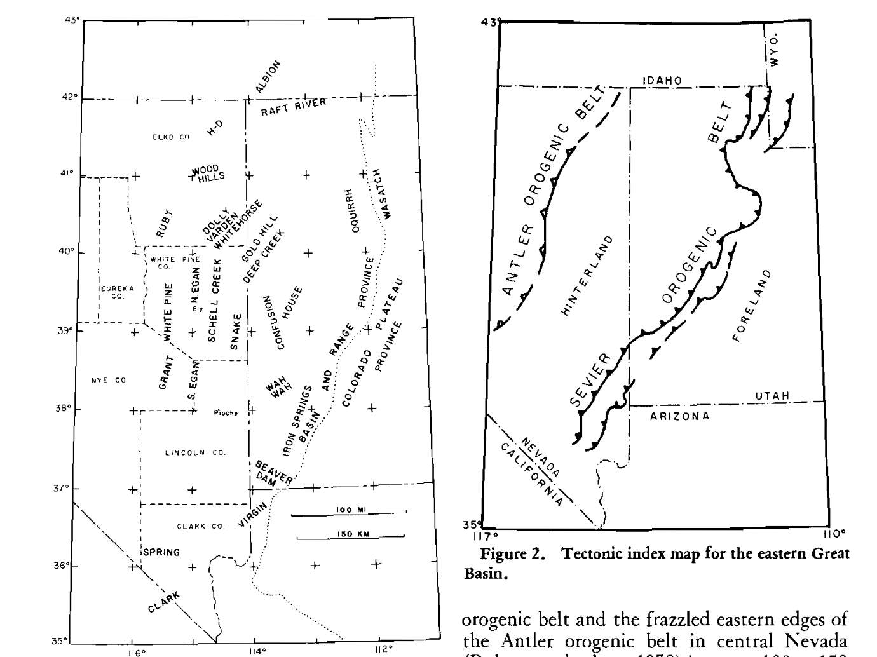
Low-Angle (Denudation) Faults, Hinterland of the Sevier Orogenic Belt, Eastern Nevada and Western Utah
Richard Lee Armstrong
Claim:
Denudation faulting in E. B&R are unrelated to the Sevier orogenic belt.
They are of Tertiary age, relating to some earlier extensional phenomenon
Notes:
The authors believe to be a significant key to the tectono-magnetic processes of the region
As subduction transformed into San Andreas, extension re-oriented 50 degrees further clockwise (to current position)

Slide 2
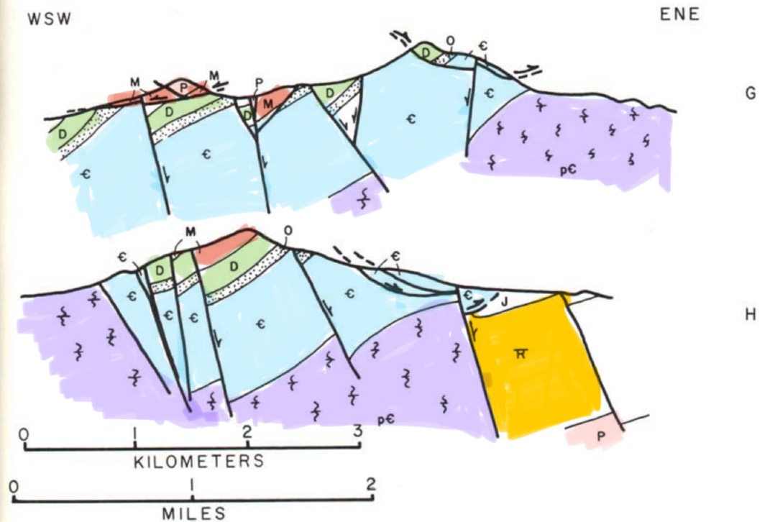
What are Glide Blocks?
Also referred to as gravity slides
Younger rock with low-angle contact on older rock
Age
Notes:
The rocks are usually intensely brecciated near tectonic contacts the entire upper plate may be shattered, but some plates are not.
Underlying rocks are deformed only in a thin zone close to the tectonc contact

Slide 3
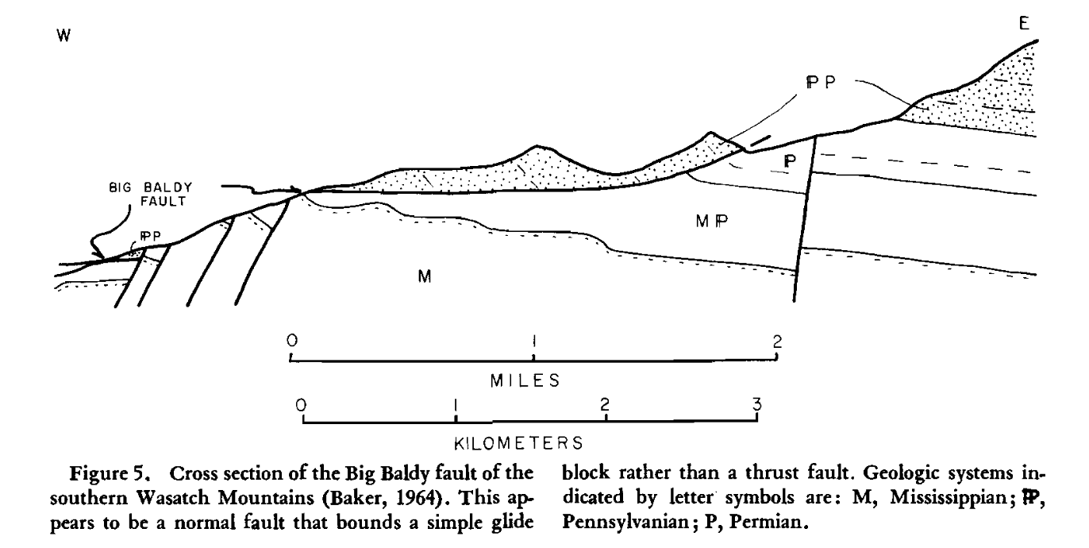
Example of Reinterpretation: Big Baldy

Slide 4
Relation to Sevier Orogeny
It is argued that denudation and gliding is directly related to the Sevier thrust belt.
Armstrong argues that:
The age of denudement predates the Sevier thrust belt
The magnitude of thrusting required is at least 1 magnitude larger than what we have observed
Ergo, unrelated…

Slide 5
“Arguments about mechanism are, for the most part unsatisfactory and inconclusive, as they require knowledge we do not have on the large-scale behavior of rocks. I prefer to analyze what has happened, geometrically and chronologically, rather than to try to answer abstract questions of how it happened.”

Slide 6
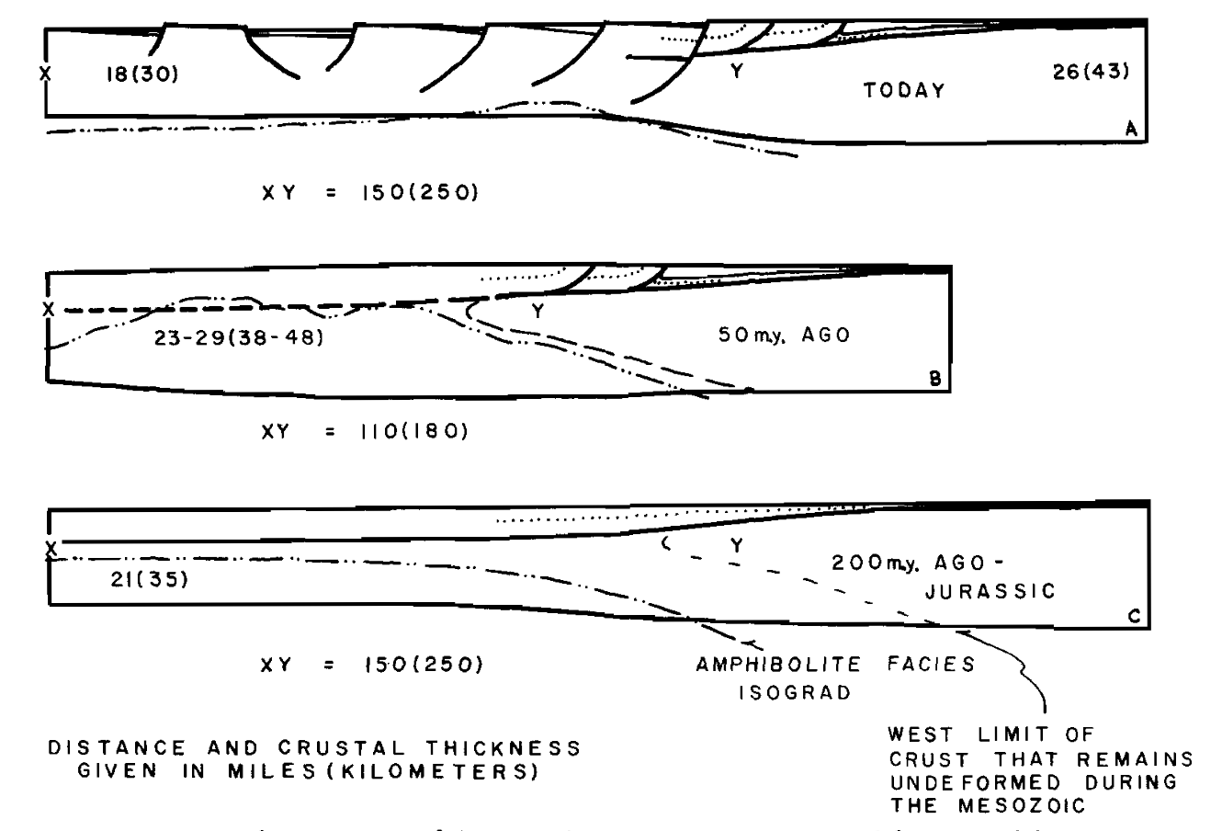
Armstrong’s model for past 200 m.y.
Close to sea-level. Existing tectonic complexity from Paleozoic/Triassic
Regional compression and isostatic uplift (Sevier thrust)
Volcanism and extension

